Slide 1
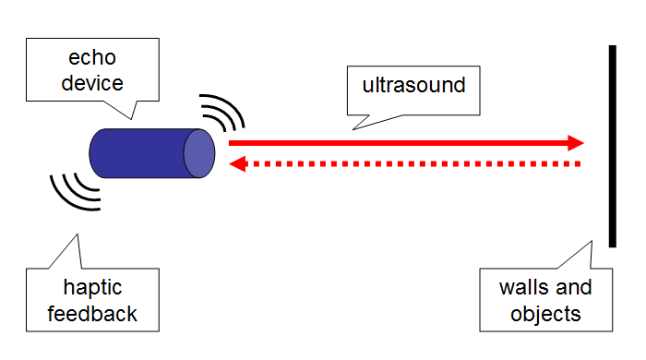
the concept
The team was formed around the idea of helping visually impaired users by designing a handheld ultrasonic device that provides haptic feedback through vibrations that increase and decrease proportional to the distance of objects you are pointing to in the immediate environment.

